Slide 1

Ramrao Adik Institute of Technology
Department of Computer Engineering
Final Year Presentation
On
“ PlantD - Health & Disease Finder”
By
19EE1138 - Abhishek B. Sharma
19EE1136 - Shivam R. Mishra
19EE1038 - Jainam D. Kothari
Guided by
Mrs. Ashwini Raorane
Notes:
‹#›

Slide 2
Content
Introduction
Literature Survey
Motivation & Objective
Proposed Methodology
Dataset Flow
Block Diagrams
Algorithm Implementation
App software implementation
Results
Future Scope
Conclusion
References
‹#›

Slide 3
Plant D
How can it help farmers?
Do Farmers really want such products?
How will it affect the efficiency and growth of farmers?
Can it help increasing profits, and is it viable?

Slide 4
Introduction
In India, agriculture is a very important part of our economy. Till people need food to eat there is a need of having very healthy produce.
A Plant's health is also important as it represents the hard work put in by the one who grows them. Thus, we need a system that can monitor the plant’s health for him so that his hard work doesn’t go to waste.
One way for us to monitor plants’ health is by, checking if there are any diseased plants among the plant that are being grown.
If we can find these diseased plants, we can notify him and suggest him to plan how to take care of it, so it doesn’t affect other plants too, and also avoid the farmer wasting his time on growing such plants.
Thus for this purpose , we have designed a robot that can detect the diseased plant in an area and Map, and also we have integrated with a machine learning algorithm that will help us detect the infected plant.
The rover will work with a webcam, which will detect the plants and provide various images of them. We will also be using a Raspberry Pi with it as it will help us in using the machine learning algorithm.
The robot will go through the whole field computing these images and once it’s done it shall be back to its position and start again after a specified time interval
‹#›

Slide 5
Literature Survey
[1]Automatic disease diagnosis on banana leaves using deep convolutional neural networks. Sensors, 18(12), 4271.
The detection and diagnosis of plant diseases is a critical task for ensuring high crop yield and quality.
In this paper, we propose a deep learning-based approach for automatic disease diagnosis on banana leaves using convolutional neural networks (CNNs). We collected a large dataset of banana leaf images with three common diseases and healthy samples, and trained a CNN model to classify the images into four categories. The proposed approach achieved an accuracy of 97.5% on the testing dataset, outperforming other state-of-the-art methods. Our results demonstrate the potential of deep learning-based approaches for automatic plant disease diagnosis, and can be used to develop practical systems for real-time disease monitoring and management.
[2]Plant disease detection using convolutional neural networks and transfer learning. Journal of Ambient Intelligence and Humanized Computing, 12(1),
In this paper, we propose a deep learning-based approach for plant disease detection using convolutional neural networks (CNNs) and transfer learning. We collected a dataset of tomato leaf images with six common diseases and healthy samples, and trained a CNN model using transfer learning. The proposed approach achieved an accuracy of 98.77% on the testing dataset, outperforming other state-of-the-art methods. We also conducted experiments to evaluate the effect of different CNN architectures, data augmentation techniques, and transfer learning strategies on the performance of the proposed approach. Our results demonstrate the potential of deep learning-based approaches for automatic plant disease detection, and can be used to develop practical systems for real-time disease monitoring and management.
[3]Using deep learning for image-based plant disease detection. Frontiers in plant science, 7, 1419.
In this paper, we propose a deep learning-based approach for image-based plant disease detection. We collected a large dataset of plant images with different diseases and healthy samples, and trained a deep convolutional neural network (CNN) model using transfer learning.
‹#›

Slide 6
Literature Survey
The proposed approach achieved high accuracy and outperformed other state-of-the-art methods for plant disease classification..
[4]Smart farming system for plant disease detection and diagnosis. International Journal of Computer Science and Mobile Computing, 8(1),
The paper proposes a smart farming system for plant disease detection and diagnosis. The system includes a mobile application and a cloud server that uses image processing techniques and machine learning algorithms for plant disease detection. The proposed system uses a smartphone's camera to capture images of plant leaves, which are then processed using image processing techniques to extract features. These features are then used to train a machine learning model for classification of plant diseases.
[5] A plant disease detection method based on YOLOv5 and transfer learning. Journal of Intelligent & Fuzzy Systems, 40(4), 7089-7101.
This paper proposes a plant disease detection method based on YOLOv5 and transfer learning. The YOLOv5 algorithm is used to detect the location and category of diseases in plant images. Transfer learning is applied to fine-tune the pre-trained model to improve its performance on the plant disease detection task. The proposed method is evaluated on a publicly available plant disease dataset, and the experimental results show that it achieves high accuracy and fast processing speed. The proposed method can be used for real-time plant disease detection and has potential applications in precision agriculture.

Slide 7
Motivation & Objective
To build a rover that would make life of farmer easier and also provide more revenue to them .
To help farmers detect plant diseases faster, so as to take early necessary action to prevent the spread of disease.
Need for developing technique such as automatic plant disease detection to automate the process for the farmers and classification using and identification leaf image processing techniques .
To increase speed and accuracy of plant detection to eliminate the traditional slow process.
To be able to raise the standard of farmers and provide a risk free methods for farmers.
To make farmer more self efficient and to introduce farmers to modern technology to help in their farms and to empower them using it .
The Final product also focuses on the efficient solution & precaution for better action towards the diseased plant through the farmer by integrating better technological features such as a rover and mobile application.
‹#›

Slide 8
Proposed Methodology
In this project, we have used a Raspberry Pi for object detection . The power to RPI is supplied through a 12-volt power supply. When this power supply starts, the Raspberry Pi starts to run.
This in turn starts the whole circuit and the code that has been stored in the Raspberry Pi starts compiling in the backend. Now that we have started the Raspberry Pi, the robot starts all its other components ready to record.
Now we that all have started, our robot is to be placed at the starting point of the farm.
Now as the robot navigates through the farm, Its webcam is on continuously, this webcam is very important as it is the one that will help us in capturing the image of the diseased the plant .
Now as the robot moves out, the webcam captures various images and stores them, these images will be then used in our project in the ML algorithm which will help in predicting if the plant is diseased or not.
Now the Robot navigates through the farm via the help of a driver circuit, which lets it navigate the area effectively, using Gear motors and Node MCU.
Now the webcam images are stored in a file and made into test data to be used for testing our ML program.
‹#›

Slide 9
Proposed Methodology
The ML program is already been trained previously on the Dataset images which are used to train our ML program and now can be used to test on other images too.
Our model has been trained using Yolo v5 object detection technique which help in taking input of multiple leaves and give each leaves disease report to the app.
Our model uses the image classification technique to classify the various images into the category of disease they have or if no disease then they are categorized as healthy.
The Raspberry Pi is programmed with Python language and it predicts the disease for the dataset . Now, once the dataset has been classified into diseased or not diseased, we have to make use of our app to display the results.
The app will take into account this and sends a message to the user after all the classification and categorization are done to tell about the diseased plant, that farmer needs to take a step either to help the diseased plant or to remove it from the farm, so it doesn’t affect the other plants and also to have a healthy environment for the other plants, and we help the farmer to just that with the help of our friendly App.
‹#›

Slide 10
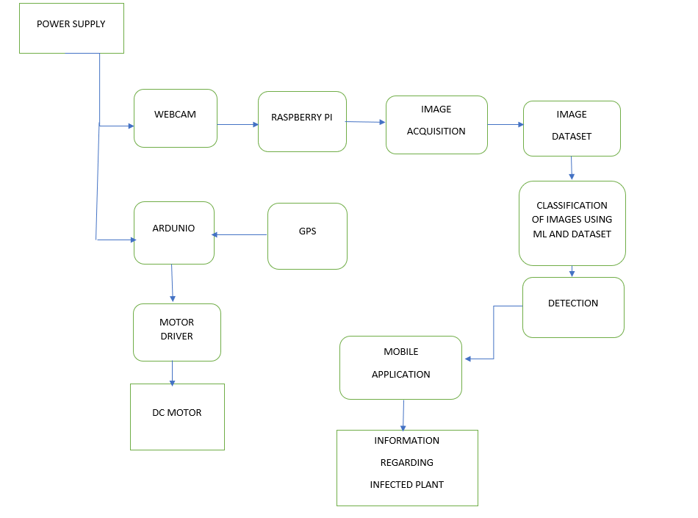
Block Diagram of the Plant Disease Detection System
‹#›

Slide 11
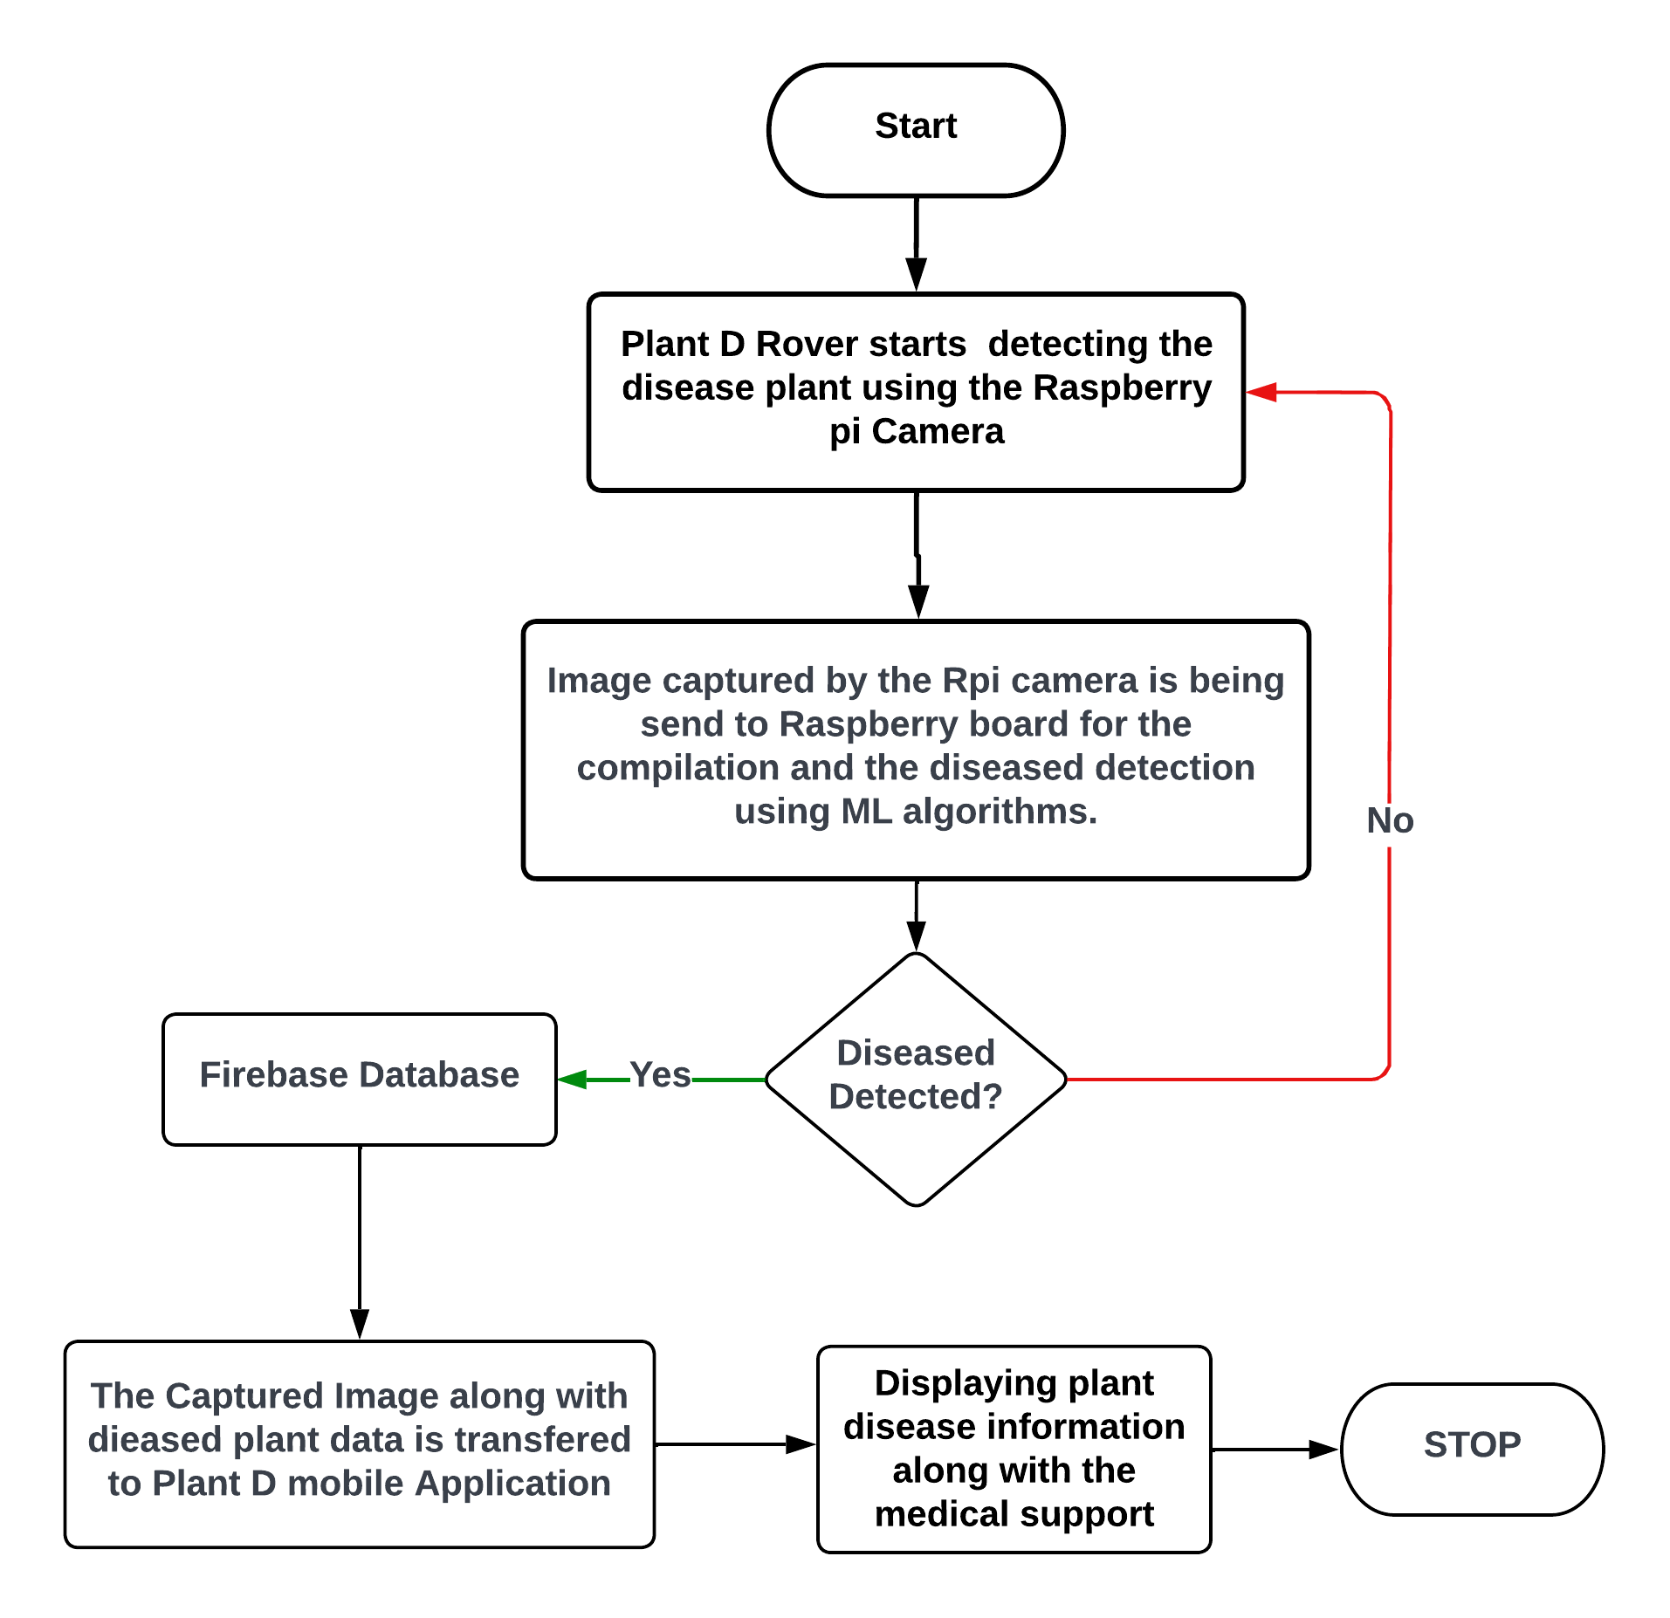
Proposed System
‹#›

Slide 12
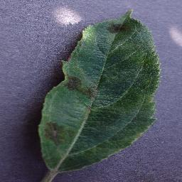
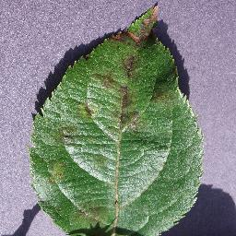
Dataset
The dataset we will be using to train the model is taken from an already existing and popular model of the New Plant Village dataset on the Kaggle platform .
This dataset consists of about 87K RGB images of healthy and diseased crop leaves, which are categorized into 38 different classes. The total dataset is divided into 80/20 ratio of training and validation set, preserving the directory structure.
Some of the images from the dataset in shown below:

Slide 13
Dataset Flow
Dataset
New Plant Diseases Dataset
Image dataset containing different
healthy and unhealthy crop leaves.
Tomato Bacterial Spot
Tomato Early Blight
Tomato Healthy
Tomato Late Blight
Tomato Leaf Mold
Tomato Septoria Leaf Spot
Tomato Spotted Spider Mites
Tomato Target Spot
Tomato Mosaic Virus
Tomato Yellow Leaf Curl Virus
This dataset consists of about 87K RGB images of healthy and diseased crop leaves, which are categorized into 38 different classes. The total dataset is divided into 80/20 ratio of training and validation set, preserving the directory structure. A new directory containing 33 test images is created later for prediction purpose.
This dataset will also be used for training the images that we will acquire from the webcam in future.
‹#›

Slide 14
Design & Implementation
Implementation of algorithm using pre trained model is studied.
Support Vector Machine(SVM)
Random Forest
State of art CNN architectures are Alexnet, VGG, Resnet, MobileNet.
The Training has been performed with
YOLO V5
Flutter based app for the farmer’s phone to get the details of the diseased plant.
YOLO V5 is a family of compound-scaled object detection models trained on the Custom dataset, and includes simple functionality for Test Time Augmentation (TTA), model ensembling, hyperparameter evolution, and export to ONNX, CoreML and TFLite.
‹#›

Slide 15
Algorithm Implementation
Support Vector Machine(SVM)
The goal of the SVM algorithm is to create the best line or decision boundary that can segregate n-dimensional space into classes so that we can easily put the new data point in the correct category in the future. This best decision boundary is called a hyperplane.But this has a limitation that it can only classify the image but cannot be used for prediction , Requiring use to use another Machine learning algorithm.
Random Forest
Random forest is a multi-class problem solver that can handle both numerical and categorical data. Random Forest is a classifier that classifies distinct subsets of a dataset using a number of decision trees. The random forest accumulates and anticipates data from each tree, then predicts the ultimate output based on the majority of votes, rather than relying on a single decision tree. This is also only traditional Algorithm even though it provides a better accuracy than the SVM Method.
YOLO v5
YOLOv5 is a family of compound-scaled object detection models trained on the COCO dataset, and includes simple functionality for Test Time Augmentation (TTA), model ensembling, hyperparameter evolution, and export to ONNX, CoreML and TFLite.
‹#›

Slide 16
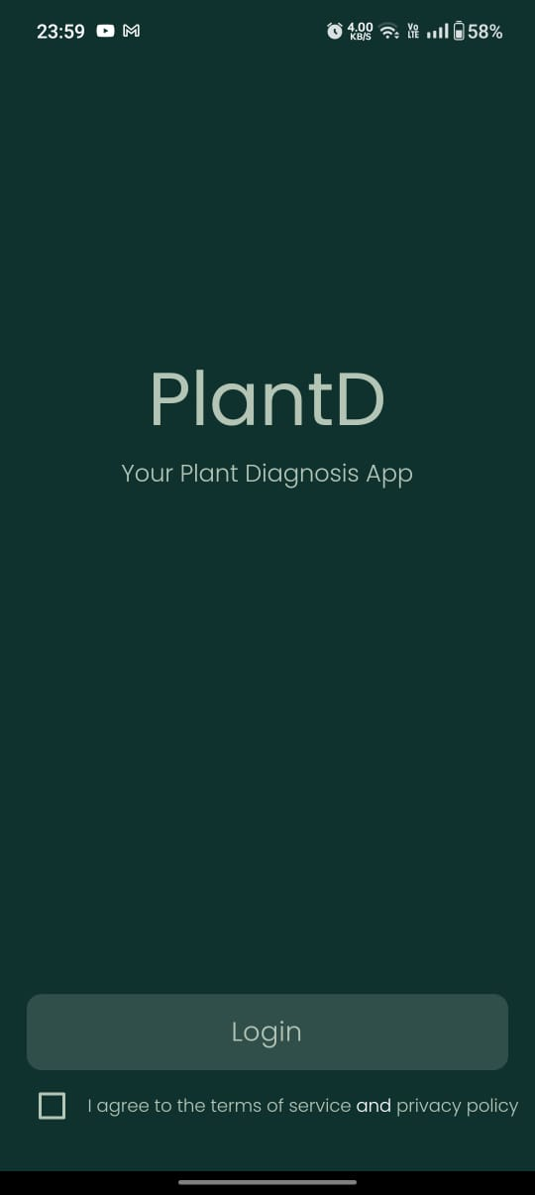
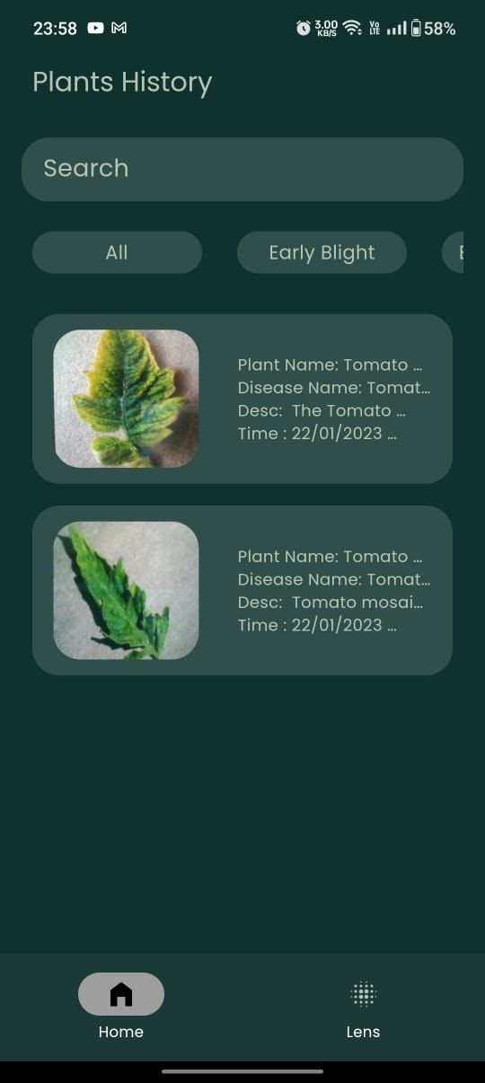
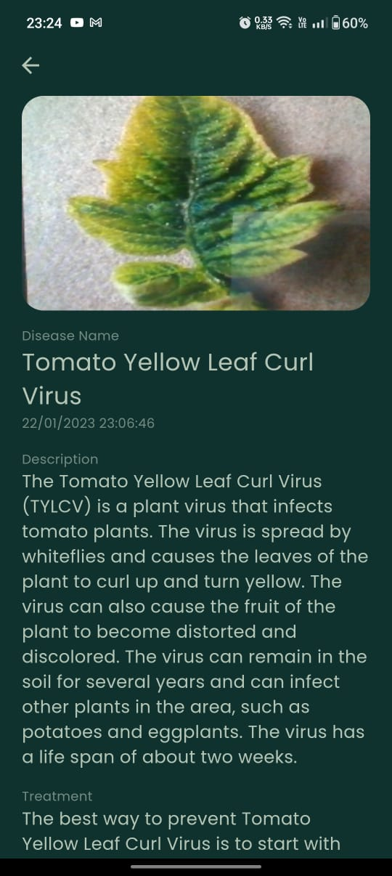
App software implementation
fig 1
fig 2
fig 3

Slide 17
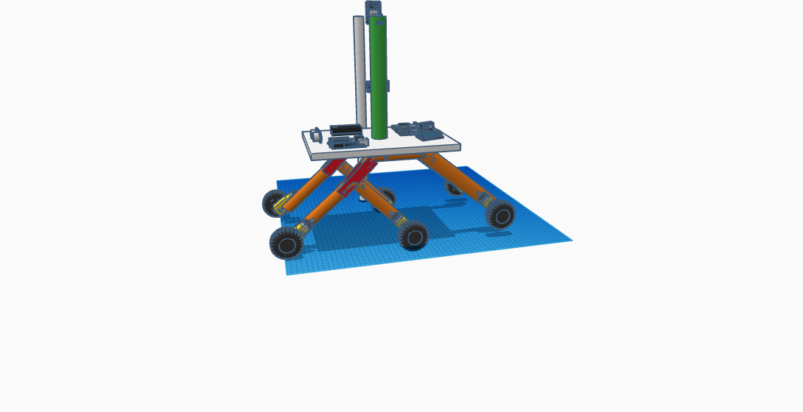
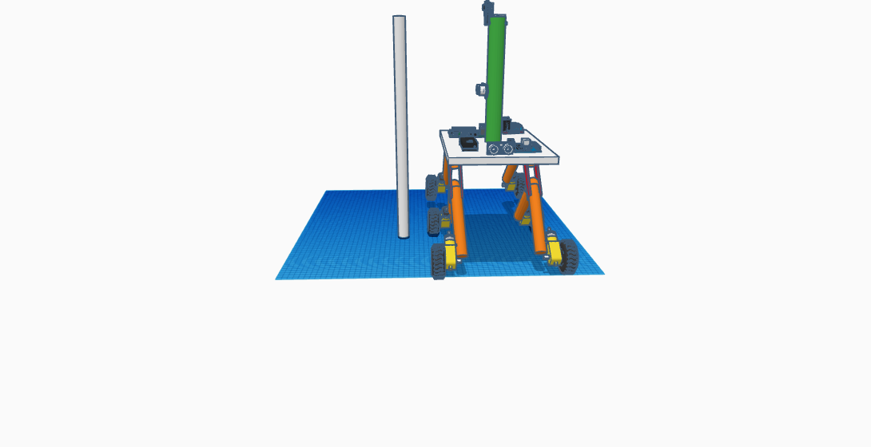
MODEL 3-D VIEW DIAGRAM
Plant D- Rover Design

Slide 18
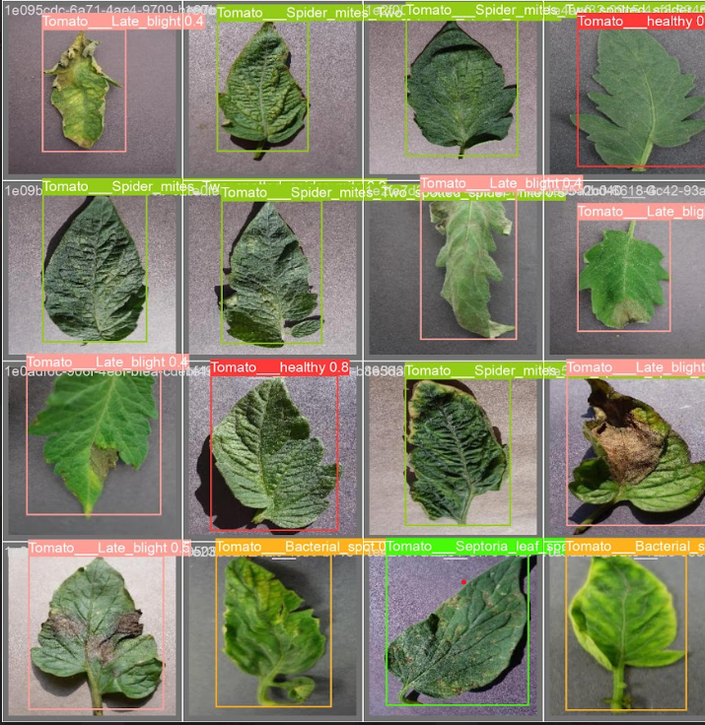
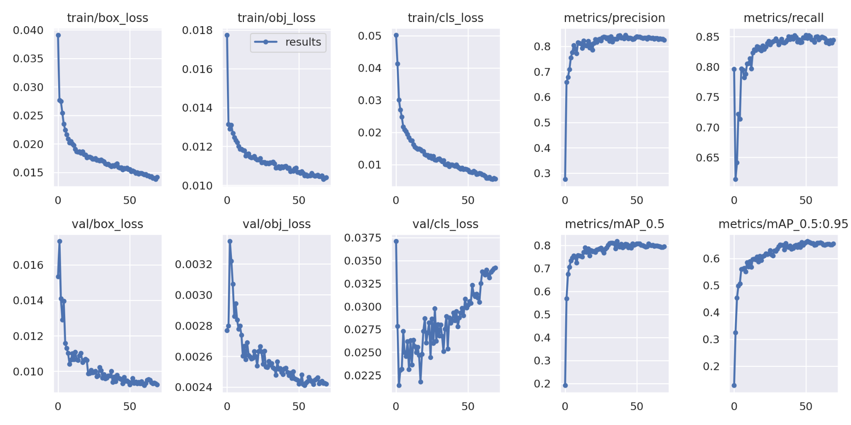
Results

Slide 19
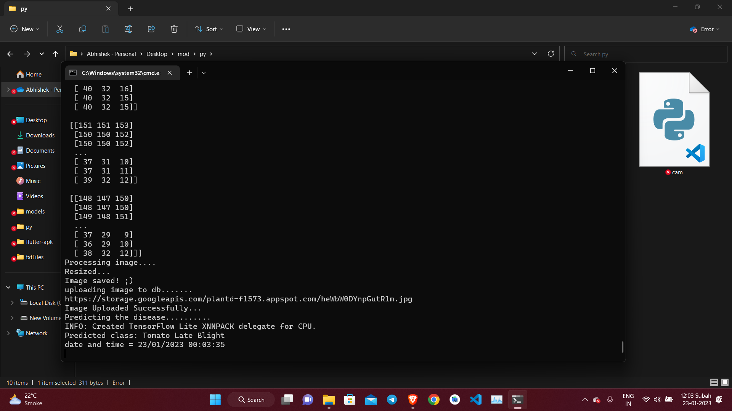
Results

Slide 20
Future Scope
To integrate this model with new algorithms coming in future for better accuracy.
To enable users to integrate to contribute to the system by capturing more different types of plants which can be added to the dataset.
Enhancement of mobile application to store each and every important data related to plants for future analytics.
Adding Doctor consultant Support regarding plant diseases and prevention in the future.
Giving the rover its own wireless network i.e., GSM to be independent.
Implementation of ML based navigation on farming field.
‹#›

Slide 21
Conclusion
In this machine learning algorithm is used with the goal to detect diseases in the crops. The model is basically tested on different types of plant species with different types of plant diseases. The model was made using Tensor flow and Keras frameworks and the system is implemented on Android. The overall system results show the relevant model provides us a better accuracy in detecting diseases.
As an extension to the project, the number of classes of plants and their diseases will be increased. Also, the model will be further improved by increasing the parameters for training and testing.
Moreover, we also have a live robot that captures also this while moving through the farm to carry the detection mechanism throughout the field.
‹#›

Slide 22
References
1)Yang, C., Zhang, Y., Niu, Y., Yuan, X., Yang, H., & Xie, Y. (2018). Automatic disease diagnosis on banana leaves using deep convolutional neural networks. Sensors, 18(12), 4271. https://doi.org/10.3390/s18124271
2)Kumar, N., Belwal, A., & Pandey, A. K. (2021). Plant disease detection using convolutional neural networks and transfer learning. Journal of Ambient Intelligence and Humanized Computing, 12(1), 937-952. https://doi.org/10.1007/s12652-020-02604-2
3)Mohanty, S. P., Hughes, D. P., & Salathé, M. (2016). Using deep learning for image-based plant disease detection. Frontiers in plant science, 7, 1419. https://doi.org/10.3389/fpls.2016.01419
4)Kulkarni, P., & Kulkarni, P. (2019). Smart farming system for plant disease detection and diagnosis. International Journal of Computer Science and Mobile Computing, 8(1), 9-17
5)Cheng, J., Yang, Q., Zhang, J., Ma, Y., & Cheng, Y. (2021). A plant disease detection method based on YOLOv5 and transfer learning. Journal of Intelligent & Fuzzy Systems, 40(4), 7089-7101.
‹#›

Slide 23
Thank You

